Slide 1
Makefiles

Slide 2
What are Makefiles?
Text
“A makefile is a file containing a set of directives used with the make build automation tool. Most often, the makefile directs make on how to compile and link a program.”
Allow you to reduce build times by only compiling files that have been changed.

Slide 3
How it happens
Text
A C/C++ source file must be recompiled when changed. If a header file has changed, each C/C++ source file including the header file must be recompiled.
Compilation produces an object file (.o) corresponding to the source file. Object files are linked together by the linker to produce the executable. The linker also resolves references to other libraries, etc.
Where does the the linker search for libraries/include files?
The directory that you specify for the file (If you specify a path with the file, the linker searches only that path and stops linking if the file cannot be found there.)
The current directory, if you did not specify a path
The value of the environment variable LIBPATH, if defined
These instructions with their dependencies are specified in a makefile.

Slide 4
How to write a makefile
Text
A makefile typically consists of many entries. Each entry has:
a target (usually a file)
the dependencies (files which the target depends on)
commands to run, based on the target and dependencies.

Slide 5
Makefile syntax
Text
The basic syntax of an entry looks like:
<target>: [ <dependency > ]* [ <TAB> <command> <endl> ]+
For example:
Movie.o: Movie.cpp Movie.h Vector.h g++ -Wall -c Movie.cpp

Slide 6
Macros
Text
Macros allow you to define "variables" which are substituted in.
Instead of:
p1 : MovieList.o Movie.o NameList.o Name.o Iterator.o g++ -Wall MoveList.o Movie.o NameList.o Name.o Iterator.o -o p1
Define macros:
OBJS = MovieList.o Movie.o NameList.o Name.o Iterator.o CC = g++ DEBUG = -g
p1 : $(OBJS) $(CC) $(LFLAGS) $(OBJS) -o p1

Slide 7
Dummy Targets
Text
make clean: remove a directory of all .o files and executables.
make all: if you need to create more than one executable or do more than one task.
make tar: When you submit files, you will often have to tar many files together.

Slide 8
Common Errors
Text
Failing to put a TAB (don’t use spaces!) at the beginning of commands
Putting a TAB at the beginning of blank lines
Make sure you are using tabs and not spaces!!

Slide 9
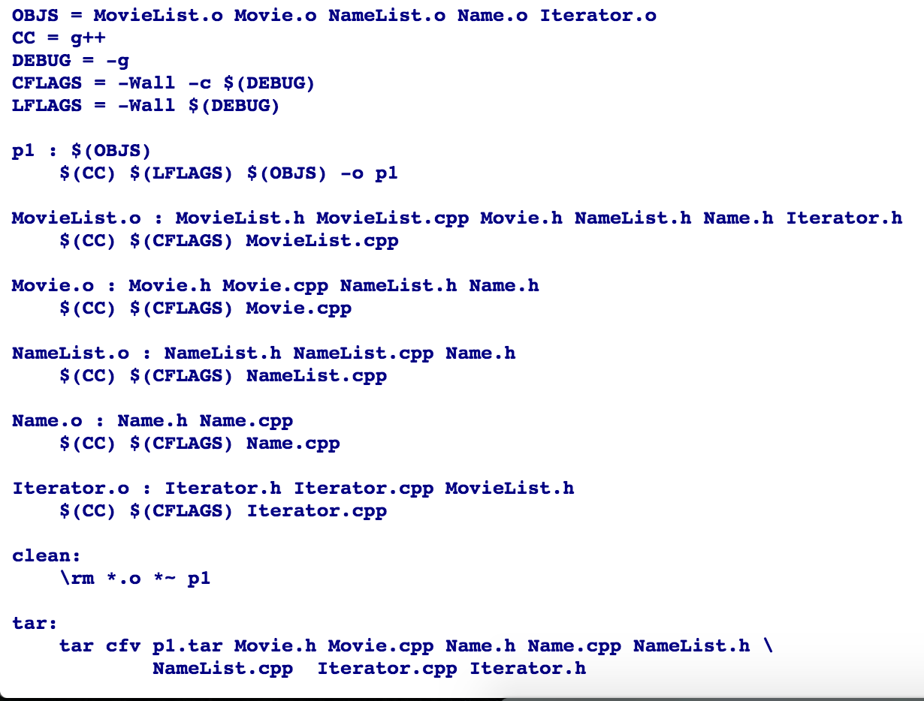
Makefile example
Text

Slide 10
Libraries
Text
A library is a file containing several object files, that can be used as a single entity in a linking phase of a program. Normally the library is indexed, so it is easy to find symbols (functions, variables and so on) in them.
Static libraries are just collections of object files that are linked into the program during the linking phase of compilation, and are not relevant during runtime.

Slide 11
AR and ranlib
Text
The basic tool used to create static libraries is a program called 'ar', for 'archiver'.
ar rc libutil.a util_file.o util_net.o util_math.o
Creates a static library named 'libutil.a' with object files "util_file.o", "util_net.o" and "util_math.o" in it. 'c' flag: create the library if it doesn't exist. 'r' flag: replace older object files in the library with the new object files.
After an archive is created, or modified, there is a need to index it to speed up symbol-lookup inside the library.
ranlib libutil.a
Using the library
cc main.o -L. -lutil -o prog
Create a program using object file "main.o", and any symbols it requires from the "util" static library. The linker attaches lib prefix and .a suffix back to the name of the library to create a name of a file to look for. -L flag: tells the linker that libraries might be found in the given directory -l flag: links with a library file

Slide 12
sources
Text
https://www.cs.umd.edu/class/fall2002/cmsc214/Tutorial/makefile.html
http://docencia.ac.upc.edu/FIB/USO/Bibliografia/unix-c-libraries.html
http://stackoverflow.com/questions/3322911/what-do-linkers-do
http://www.rapidtables.com/code/linux/gcc/gcc-l.htm
https://en.wikipedia.org/wiki/Makefile

